Slide 1

TRAVEL AND TOURISM DATA
Done By : - MTV Soumith(2010030097)
C.Koushik reddy(2010030027)
D.Chaitanya(2010030045)

Slide 2
TABLE OF CONTENTS
Project Area
Literature Survey
Problem Statement
Conclusion

Slide 3
PROJECT AREA
Our dataset Comes Under Statistical data.
Predictive analytics: One of the most crucial applications of statistical data analysis, predictive analytics allow you to use past numerical data to predict future outcomes and areas where your team should make adjustments to improve performance.
We are going to analyze the data and predict which places, hotels, flights are suitable for people.

Slide 4
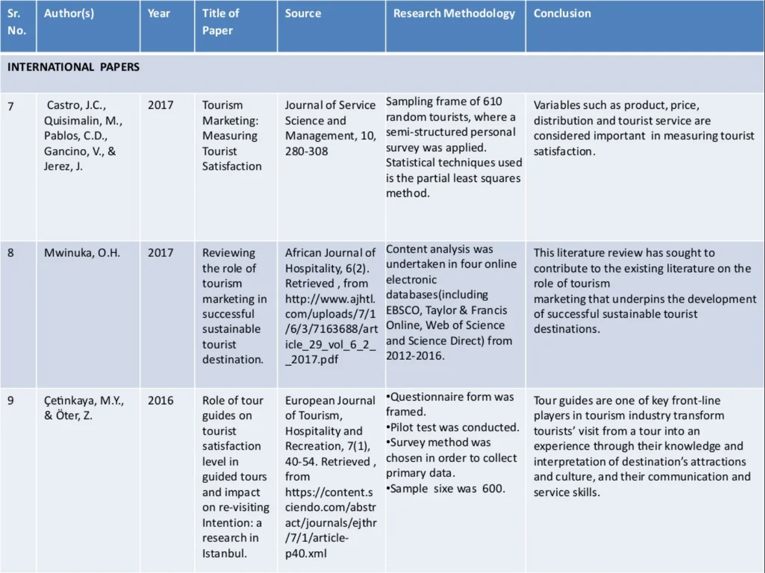
1
2
3

Slide 5

PROBLEM STATEMENT
Most of the people will face problems on selecting the right flights, hotels.
So we will analyze the previous available tourism data and predict the best hotels, fights etc.,

Slide 6

CONCLUSION
In this Project we will visualize the travel data in various graphs and predict the best hotels, flights, combos for the users.

